Slide 1


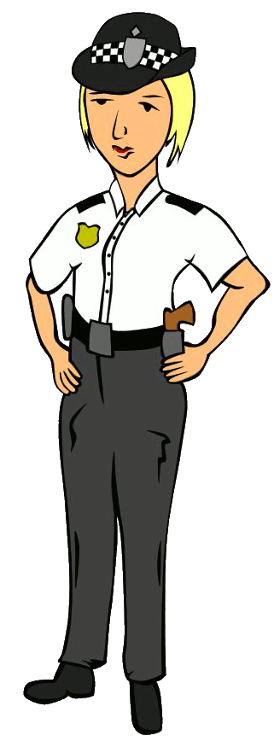
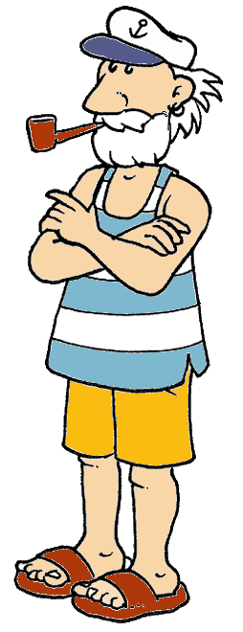
PICTIONARY
BY HERBER

Slide 2



17 / 50
doctor

Slide 3
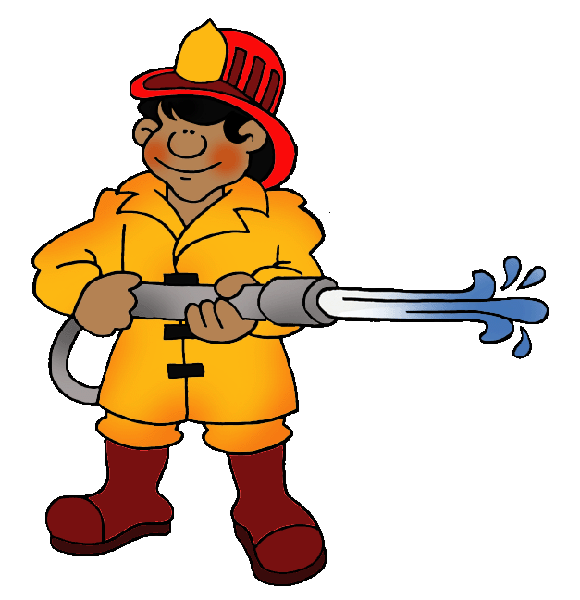
21 / 50
firefighter

Slide 4

35 / 50
police officer

Slide 5

46 / 50
vet

